Slide 1
GRADUATE SCHOOL OF SOCIAL SCIENCES

Slide 2
PRESENTATION SUMMARY
MISSION
VISION
ACADEMIC STRUCTURE
BOARD OF DIRECTORS
ADMINISTRATIVE STRUCTURE
ADVISORY BOARD
DEPARTMENTS
PROGRAMS
STUDENT ADMISSION
NUMBERS
BILATERAL AGREEMENTS
ACCREDITATION
PHYSICAL INFRASTRUCTURE

Slide 3
MISSION
Social Sciences Institute,
It has undertaken to raise individuals who research and question in the fields of social and human sciences, who can think in a holistic framework, and who protect their cultural values.
In addition, it has taken it upon itself to serve the society by contributing to the development of scientific knowledge and to contribute to the development of the country and the region.

Slide 4
VISION
To be an Institute that produces knowledge at a universal level, incorporates scientific technology into the teaching process, transforms scientific stance into culture and has competitive power.

Slide 5
Academic Organization

Slide 6
BOARD OF DIRECTORS
Associate Professor Özkan HAYKIR Phd. Assistant Director | Professor H. Işın DİZDARLAR ERDOĞAN Phd. Manager | Dr. Öğr. Üyesi Turgay DÜGEN Assistant Director
Professor Nevzat TOPAL Phd. Board Member | Associate Professor Ramis KARABULUT Phd. Board Member | Associate Professor Ayşe TOPAL Phd. Board Member

Slide 7
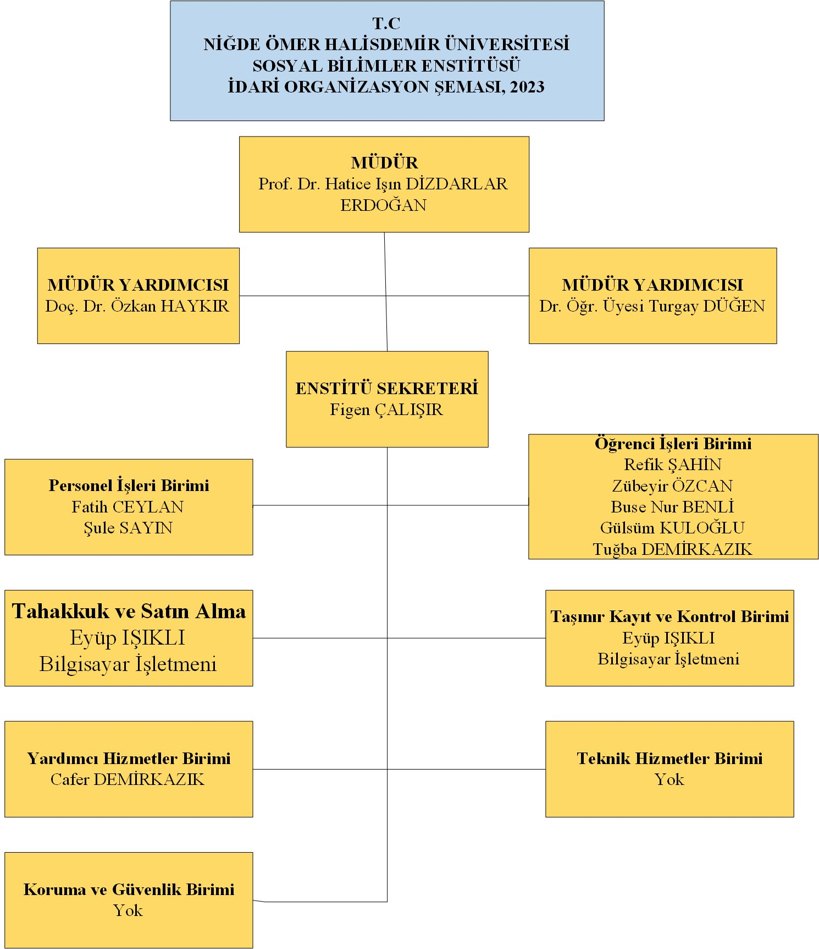
Administrative Organization

Slide 8
Advisory Board Members
Adı Soyadı | Kurumu
Ogün SONGUR | Niğde Vice President of the Chamber of Commerce and Industry
Halil DEMİRDİLEK | Niğde President of the Chamber of Independent Accountants and Financial Advisors
Songül ÇALIŞKAN | Turkish Disabled People Association Niğde Branch President
Umut ZEYREK | Niğde Aile ve Sosyal Hizmetler Müdürü
Ali İlker ATABAY | Bor Karma Organize Sanayi Bölgesi Müdürü
Uğur DURMAZ | VakıfBank Niğde Şube Müdürü
Mehmet Sinan Çelik | Dr. Öğr. Üyesi

Slide 9
DEPARTMENTS
 | Opening Year
EURASIAN STUDIES | 2014-2015
BANKING AND FINANCE | 2018-2019
PHYSICAL EDUCATION AND SPORTS | 1994-1995
GEOGRAPHY | -
CONTEMPORARY TURKISH DIALECTS AND LITERATURES | 2018-2019
ECONOMY | 1994-1995
COMMUNICATION SCIENCES | 2023-2024
ISLAMIC HISTORY AND ARTS | -
BUSINESS ADMINISTRATION AND MANAGEMENT | 1994-1995
PUBLIC ADMINISTRATION | 1995-1996
FINANCE | 2018-2019
MUSICOLOGY | 2015-2016
HEALTHCARE MANAGEMENT | 2014-2015
POLITICAL SCIENCE AND INTERNATIONAL RELATIONS | 2018-2019
SOCIOLOGY | 2012-2013
HISTORY | 1996-1997
BASIC ISLAMIC SCIENCES | 2022-2023
TURKISH LANGUAGE AND LITERATURE | 1996-1997
TURKISH MUSIC | 2022-2023
INTERNATIONAL TRADE AND LOGISTICS MANAGEMENT | 2018-2019

Slide 10
PROGRAMS
DEPARTMENTS | TEZLİ | TEZSİZ | DOKTORA
EURASIAN STUDIES | √ |  | √
BANKING AND FINANCE | √ |  | √
PHYSICAL EDUCATION AND SPORTS | √ |  | √
GEOGRAPHY | √
CONTEMPORARY TURKISH DIALECTS AND LITERATURES | √ |  | √
ECONOMY | √ |  | √
COMMUNICATION SCIENCES | √
ISLAMIC HISTORY AND ARTS | √
BUSINESS ADMINISTRATION AND MANAGEMENT | √ | √ | √
PUBLIC ADMINISTRATION | √ | √ | √
FINANCE | √ | √ | √
MUSICOLOGY | √ | √ | √
HEALTHCARE MANAGEMENT | √
POLITICAL SCIENCE AND INTERNATIONAL RELATIONS | √
SOCIOLOGY |  | √
HISTORY | √ |  | √
BASIC ISLAMIC SCIENCES | √ |  | √
TURKISH LANGUAGE AND LITERATURE | √ |  | √
TURKISH MUSIC | √
INTERNATIONAL TRADE AND LOGISTICS MANAGEMENT | √ |  | √

Slide 11
STUDENT ACCEPTANCE
MASTER WITH THESIS:
1) In student admission, in order for the candidates to take the interview/aptitude test, 60% of the candidate's ALES score and 40% of the undergraduate graduation grade point average are added to the ranking and 4 times the determined quota are announced. While calculating the entrance success score, undergraduate graduation GPA, ALES score and interview/talent score are evaluated. Entry success score; It is calculated by adding 50% of the candidate's ALES score, 30% of his undergraduate graduation grade point average and 20% of the score he received from the interview/aptitude test. In order for candidates to be considered successful, the calculated entrance success score must be at least 65 points out of 100.

Slide 12
2) ALES score is not required for admission of students to the departments and art branches in the institutes of the faculty of fine arts and conservatory. For the interview/aptitude test, the candidate is ranked according to his/her undergraduate graduation grade point average and candidates 4 times the quota are invited to the interview/aptitude test. Entry success score; It is calculated by adding 50% of the candidate's undergraduate graduation grade point average and 50% of the score he received from the interview/aptitude test. In order for candidates to be considered successful, this calculated score must be at least 65 points out of 100.

Slide 13
STUDENT ACCEPTANCE
NON-THESIS MASTER:
Non-thesis master's degree entrance success score is calculated by taking into account the undergraduate graduation grade point average. The Institute Board of Directors ranks the candidates according to their undergraduate graduation grade point average. The two digits after the decimal point are taken into account in the score ranking. If the scores of the last ranked candidates are equal as a result of the ranking, the quota is increased to include the relevant candidates.

Slide 14
STUDENT ACCEPTANCE
DOCTORATE
For the interview/aptitude test in doctoral programs, 60% of the candidates' ALES or TUS basic score, 40% of the undergraduate GPA of candidates applying with a bachelor's degree, and 40% of the graduate GPA of candidates applying with a thesis master's degree are collected and the ranking is made. Candidates 4 times the quota are invited. Entry success score; It is calculated by taking the sum of 50% of the ALES or TUS basic score, 30% of the undergraduate GPA of candidates applying with a bachelor's degree, 30% of the master's degree average of candidates applying with a thesis master's degree, and 20% of the interview/aptitude score. In order for candidates to be considered successful, the calculated entrance score must be at least 65 points out of 100.

Slide 15
OUR STUDENTS
NUMBER OF STUDENTS | 1174
ACADEMİCAL PERSONAL | 1
ADMINISTRATIVE STAFF | 10
INTERNATIONAL STUDENT | 95

Slide 16
BILATERAL AGREEMENTS
PROGRAM | NUMBER OF OUTGOING STUDENTS
ERASMUS | 48
FARABİ | -
MEVLANA | 3

Slide 17
ACCREDITATION Academic evaluation, quality improvement, professional recognition
Departments | BOLOGNA
All Departments | European Credit Transfer System (ECTS) Label, Diploma Supplement Label

Slide 18
THANKS

