Slide 1


NIĞDE ÖMER HALISDEMIR UNIVERSITY
Ayhan Şahenk Faculty of Agricultural Sciences and Technologies
ŞAHENK FOUNDATION STUDENT SCHOLARSHIP INFORMATION PRESENTATION
SCHOLARSHIP APPLICATION START DATE: 15/09/2025

Slide 2
Dear Students of Our Faculty;
The requirements for the registration of student scholarships, which are given by the Şahenk Foundation to our students who have won our Faculty of Agricultural Sciences and Technologies, during their Preparatory + Undergraduate (1+4 Years) education, every year in the academic year (9 Months/Year), are stated in the presentation.
We kindly ask you to read the information carefully and report any problems to our faculty student affairs (0388 225 44 57).

Slide 3
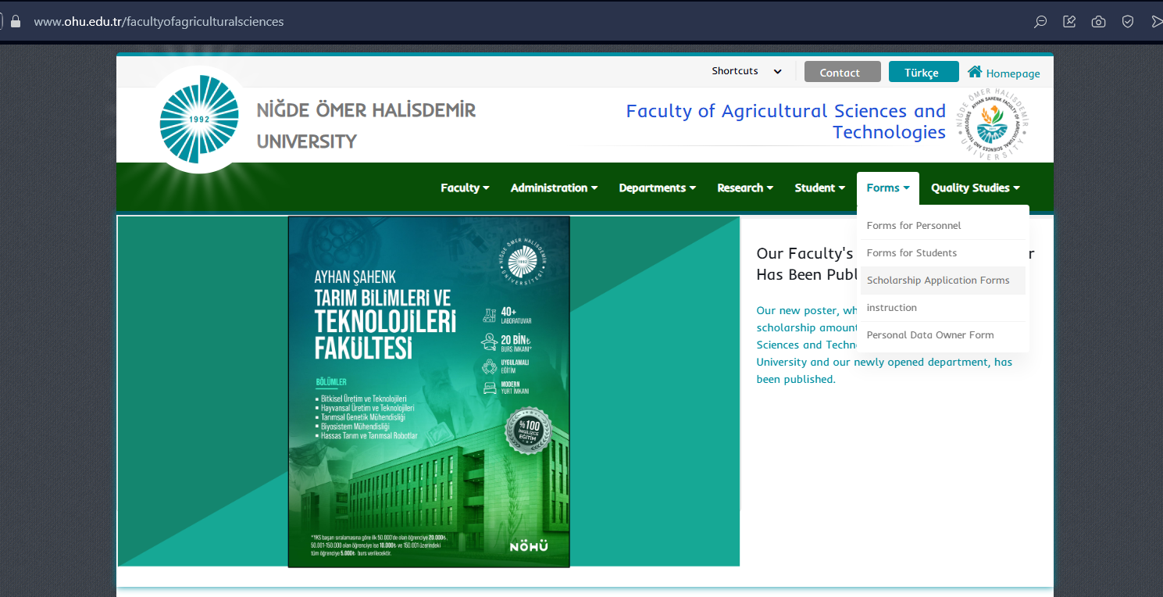
SCHOLARSHIP APPLICATION FORM
The scholarship registration form can be accessed from the Forms > Scholarship Application Form (https://www.ohu.edu.tr/facultyofagriculturalsciences/page/scholarship-application-forms) tab on the website of our faculty (https://www.ohu.edu.tr/facultyofagriculturalsciences)

Slide 4
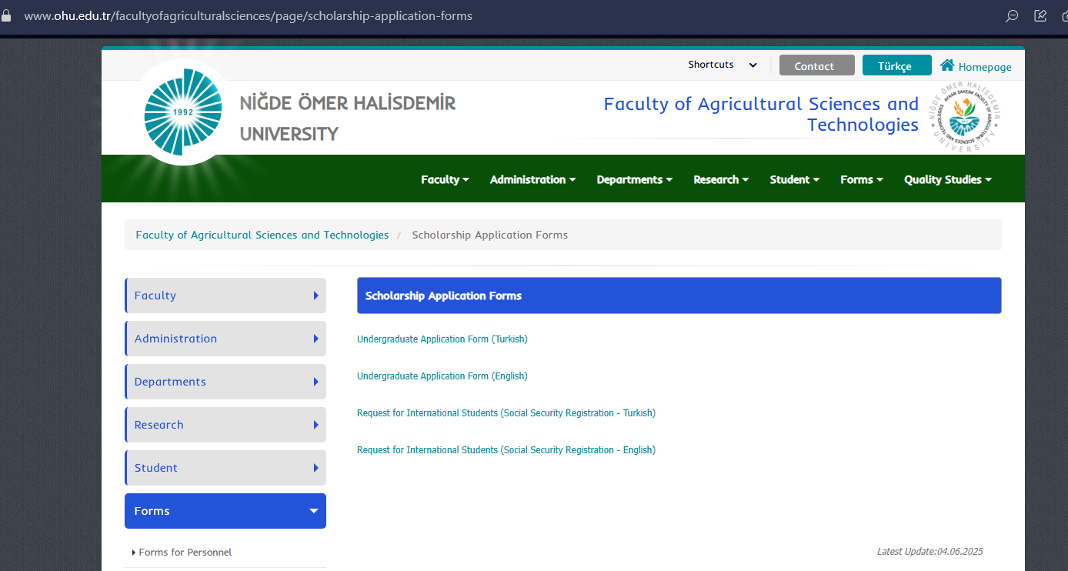
After entering the scholarship application page, click on "Undergraduate Application Form (English)" to download the application form.

Slide 5
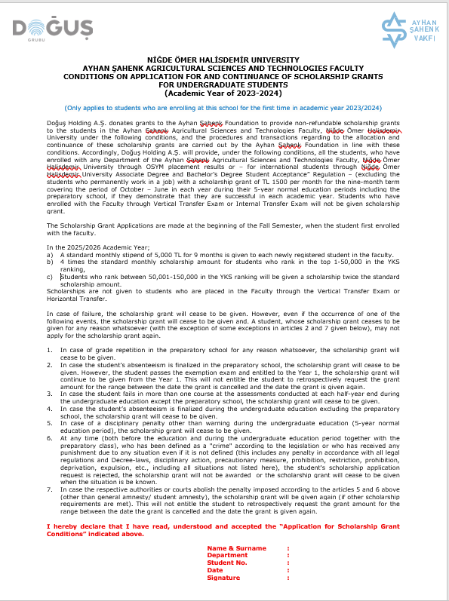
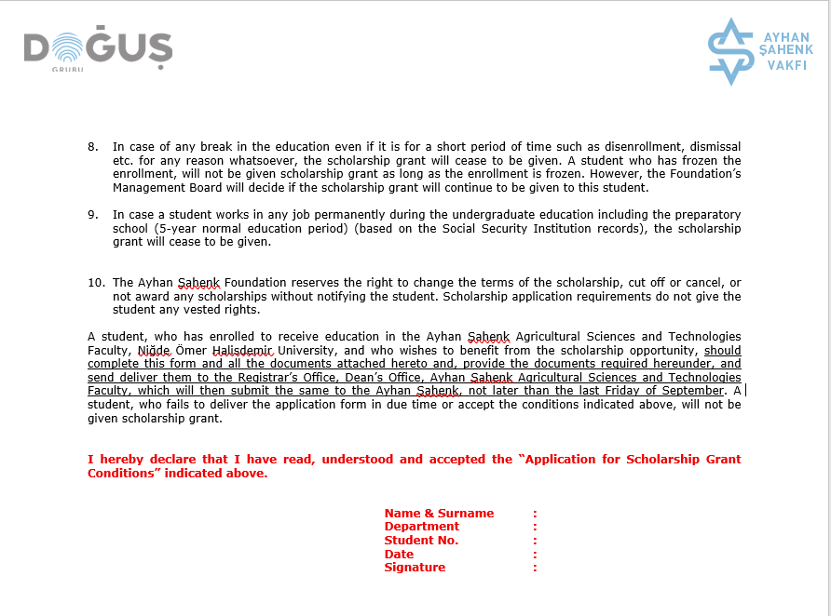
The information about the scholarship registration and attendance requirements on pages 1 and 2 should be read carefully, the information at the bottom of the page should be filled in and submitted as 'SIGNED'.

Slide 6
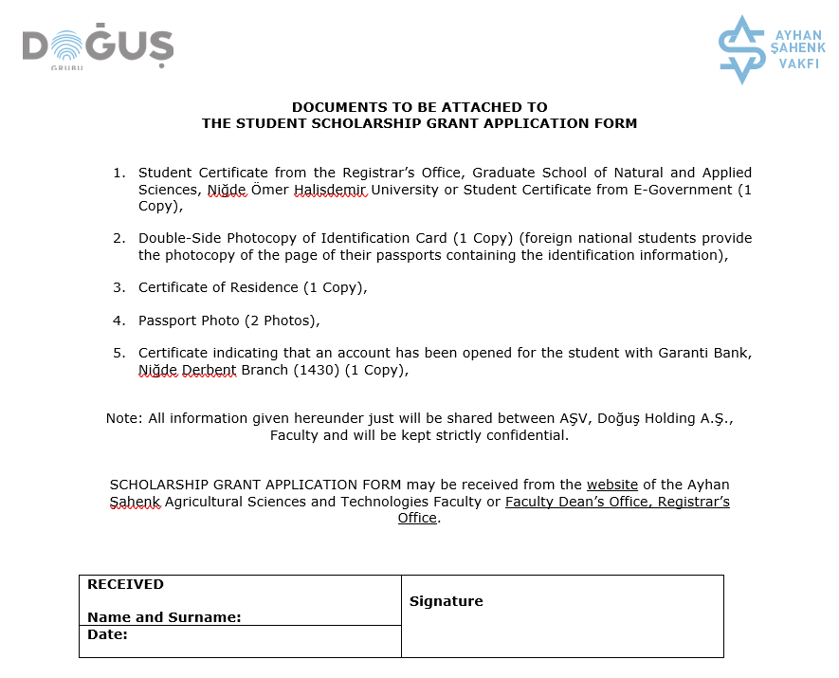
In addition to the Scholarship Application Form, the required documents are specified in the form. Make sure that the documents are complete and in the desired format.
Since it is not possible to apply for a scholarship without a student certificate, your student registration must be completed first. You can get the student certificate from the student affairs of the faculty and the student automation system of our university (OGRIS).
As stated in Article 5, an account must be opened at the Garanti Bank Niğde Branch where the scholarships will be deposited.

Slide 7
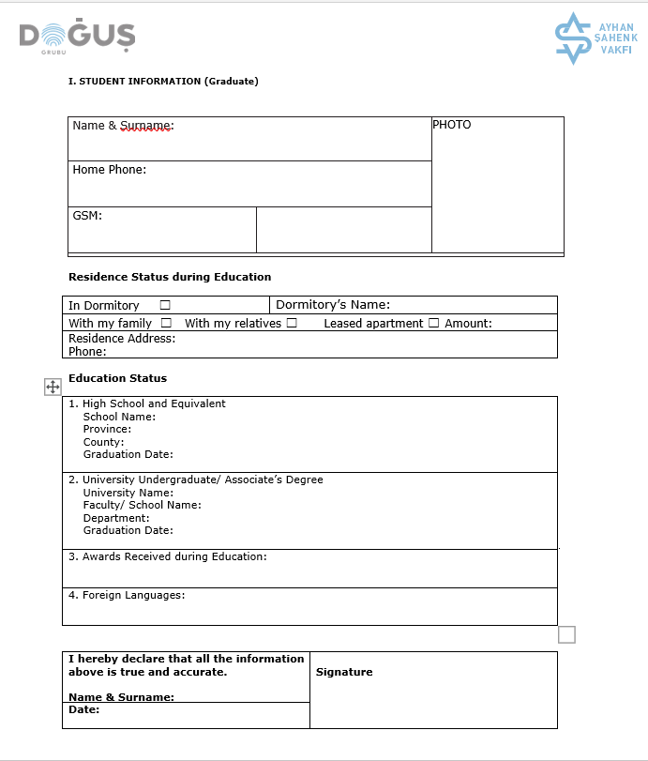
The information about the student must be filled in carefully, completely and accurately. It is not mandatory to fill it out in the absence of a home phone.
The information in article 1 of the education status, the name of the university, our faculty and the department information will be filled. The graduation date will not be filled. The 'Graduate' information in Article 2 will not be filled in by newly registered students.
ABOUT AYHAN ŞAHENK STUDENT DORMITORY, WHICH WAS BUILT FOR THE STUDENTS OF OUR FACULTY;
Ayhan Şahenk Student dormitory applications are made through the student automation system (OGRIS). You can access the student automation system with the information provided after student registration. Detailed information about the dormitory is provided by the Department of Health, Culture and Sports of our University.
Tel: 0388 225 24 66 - 225 27 17 - 225 27 09.

Slide 8
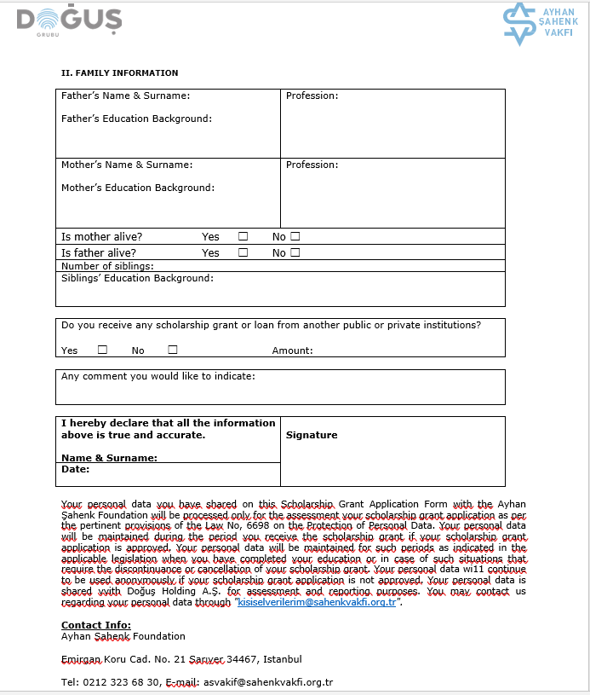
Fill in the family information and other requested information.

Slide 9
Additionally, our international students are required to complete and submit the "Request for International Students (Social Security Registration - English)" petition. The petition and sample petition can be accessed by clicking on the text below.

Slide 10
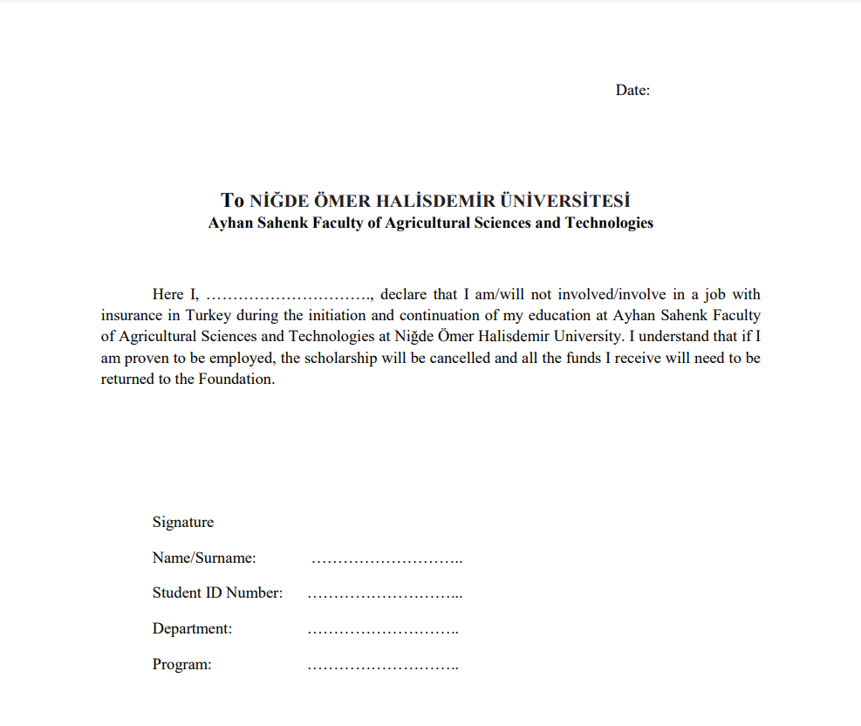

Slide 11
For detailed information, our University https://www.ohu.edu.tr
And you can follow our faculty website https://www.ohu.edu.tr/facultyofagriculturalsciences.
In addition, by following our social media accounts of our faculty, you can follow and participate in the training, events, club activities and all the activities carried out by our faculty.
Instagram: nohutbtf - https://www.instagram.com/nohutbtf
LinkedIn: nohutbtf – https://www.linkedin.com/company/nohutbtf
Facebook: nohutbtf - https://www.facebook.com/nohutbtf
X.com: nohutbtf - https://x.com/nohutbtf
YouTube: Niğde Ömer Halisdemir University Agricultural Sciences -https://www.youtube.com/@nigdeomerhalisdemirunivers8601

