Slide 1
ACADEMIC FACULTY / DEPARTMENT COORDINATORS ERASMUS DASHBOARD TRANSACTIONS Niğde Ömer Halisdemir University International Relations Office Erasmus Institutional Coordinate erasmus@ohu.edu.tr

Slide 2
Erasmus Dashboard Process Steps for Academic Faculty / Department Coordinators
Dear Erasmus+ Academic Faculty / Department Coordinator,
As of the 2021 Academic Year, the signature of Erasmus+ Department Coordinators is required for our students who are eligible for Erasmus+ Learning Mobility to complete the "Learning Agreement" processes. As of this year and semester, some of our partner universities have started to use the "Erasmus+ Dashboard" and "OLA- Online Learning Agreement" system implemented by the EU and carry out the Learning Agreement processes online, including signature procedures. (In this new process, Online Learning Agreement documents are abbreviated as OLA). In this direction, if you have Erasmus students who will study at universities using this system, the office has defined your e-mail addresses that you notified us in your assignment process through the system and after this definition, you are expected to complete the Online Learning Agreement / OLA signature process of your student by following the steps below.Thank you in advance for your cooperation and we wish you good work.

Slide 3
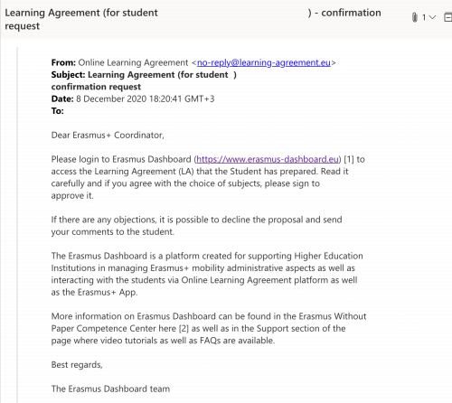
Step by Step «Erasmus Dashboard»
The relevant process starts with such a notification in your e-mail box. This e-mail means that our student, who is entitled to benefit from Erasmus mobility in the department you coordinate, has prepared the "Online Learning Agreement" document through the system and sent it to you for online signature.

Slide 4
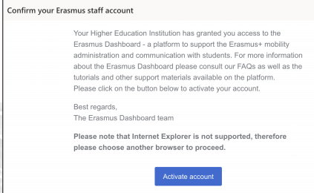
Erasmus Dashboard (1)
An identification (access permission) process has been performed by our Office to your e-mail address in the Learning Agreement document.
After this identification process, you should have received an e-mail titled "Confirm Your Account" to your e-mail address via the Erasmus Dashboard system.
If you do not see this e-mail in your "inbox", we recommend that you also check your "spam/junk" inbox.
By opening this e-mail, you are expected to confirm the relevant account and create your password by clicking on the "Activate Account" text in it.
* It is recommended that you do not use "Internet Explorer" browser to access the system.

Slide 5
Erasmus Dashboard (2)
After your password has been created please reopen the page by clicking on : https://www.erasmus-dashboard.eu/account/login

Slide 6
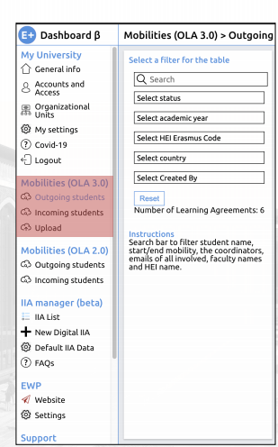
Erasmus Dashboard (3)
After logging back into the system, click on "Outgoing Students" under "Mobilities (OLA 3.0)" on the left side,

Slide 7
Erasmus Dashboard (4)
You will see the «outgoing students» part and the names of the students will be seen there
For the student whose OLA will be signed can be seen and please click on the part «open the learning agreement»

Slide 8
Erasmus Dashboard(5)
The Learning Agreement will be seen for the related student
Please check the courses and Sign OLA by using your mouse, trackpad, etc.
If you make a mistake please clear your signature and retry again.

Slide 9
Erasmus Dashboard (6)
After signing please click on the «confirm» button. The Learning agreement process will be completed.

Slide 10
Niğde Ömer Halisdemir University International Relations Erasmus Coordination Office erasmus@ohu.edu.tr
+903882252148

